Slide 1

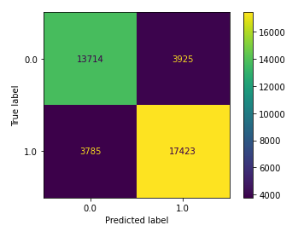
Enhancing Customer Satisfaction Through Improved In-Flight Entertainment
Prepared for: Delta Airlines Leadership Team
The analysis serves to determine the impact of in-flight entertainment (IFE) quality on customer satisfaction at Delta Airlines. Utilizing feedback from 129,880 customers, we assessed various factors including flight class, distance, and IFE quality.
The primary goal was to evaluate the correlation between IFE quality and customer satisfaction, employing binomial logistic regression to develop a model capable of predicting future satisfaction levels based on historical data.
Logistic regression predicted customer satisfaction with 80.2% accuracy.
Positive correlation between high IFE ratings and increased satisfaction.
Balanced true positives and negatives in the confusion matrix validate the model's reliability.
Model precision, recall, and F1 scores were 0.816, 0.822, and 0.819, respectively.
Prioritize the enhancement of IFE quality based on its proven correlation with customer satisfaction, aiming for innovative and engaging content.
Expand model development to include more variables such as in-flight services, seating comfort, and staff professionalism, to gain a comprehensive understanding of satisfaction drivers.
Notes:
Image Credits
Android Phone Icon: Created by Devendra Karkar from the Noun Project
iPhone Icon: Created by Landan Lloyd from the Noun Project

